Slide 1
Chatbot Anatomy

Slide 2
Chatbot Definition
Overview of Generative AI
Overview of LangChain Framework
Chatbot Process Flow

Slide 3
What is a Chatbot?
A chatbot is a software application used to conduct conversations.
It mimics human conversational abilities using Natural Language Processing (NLP).
Modern chatbots leverage LLMs like GPT-4 and frameworks such as LangChain to generate responses.
Our chatbot will integrate with OpenAI's API to generate natural language responses.

Slide 4
Generative AI
Artificial intelligence systems that can create new content, such as text, images, music, and more, based on the data they have been trained on. These systems learn patterns from the input data and use this knowledge to generate new, similar, and often novel data.
Content Creation: text->text, text->image, image->text
Entertainment: designing characters, creating game environments
Healthcare, Marketing and Advertising, Education
Examples: ChatGPT, DALL-E, MidJourney, OpenAI’s MuseNet,

Slide 5
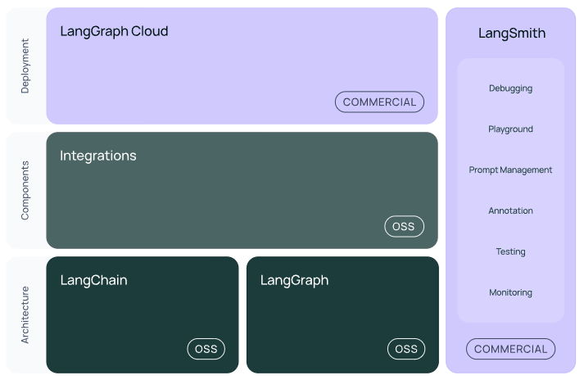
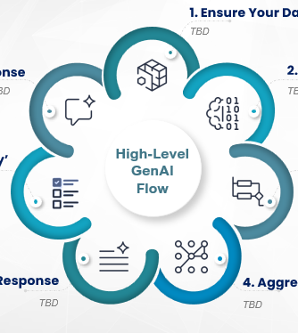





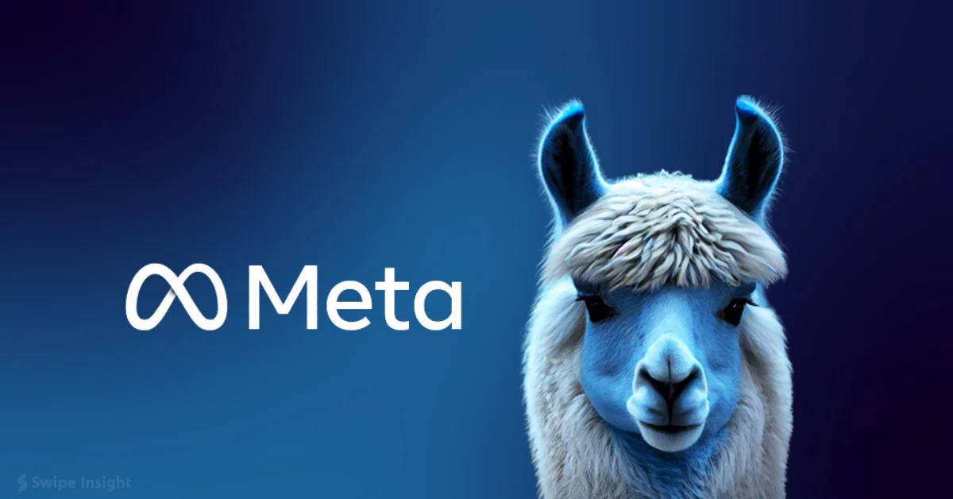
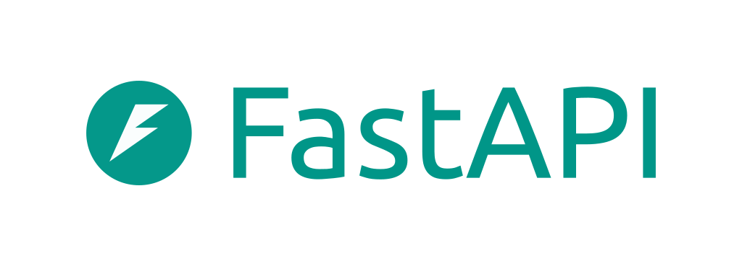


Chatbot and LangChain Framework
Blend into circle diagram
LLM
HumanMessage
[role: “user”]
AIMessage
[role: “assistant”]
Prompt Templates
Prompt Value
Output Parser
SystemMessage
[role: “system”]
ToolMessage
[role: “tool”]

Slide 6



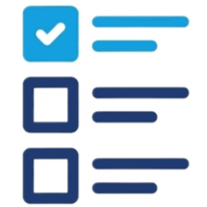
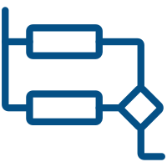


GenAI Solutions follow a similar high-level ‘workflow’
1. Ensure Your Data & Systems are ‘GenAI-Ready’
Project Initiation
7. Deliver a High-Quality Response
2. Understand the User’s Request
5 & 6 formatted w/OutputParser
User Acceptance Criteria
6. Check for Quality and ‘Toxicity’
High-Level
GenAI
Flow
3. Route the Request(s)
Comprehend Toxicity
Comprehend Prompt Safety
Comprehend PII
LangChain LCEL
5. Generate a Targeted Response
4. Aggregate Required Data & Context
Prompt Management
Single Document Vector Store - ChromaDB

Slide 7
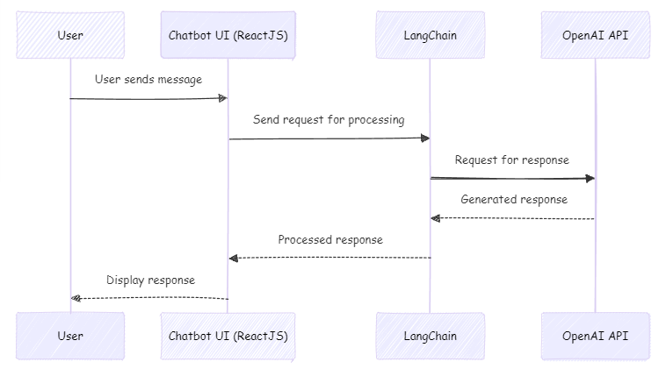
Chatbot Flow
Blend flatten circle

Slide 8
API Integration
The chatbot interacts with LLMs via APIs like OpenAI API.
FastAPI routes incoming requests from the ReactJS client asynchronously and passes them to LangChain.
Environment variables (.env) are used to securely manage API keys for OpenAI, loaded via python-dotenv.

Slide 9
Q&A

Slide 10
Coding Exercise
> git clone https://github.com/marty916/Enterprise-LLM-RAG.git
> cd Enterprise-LLM-RAG/lessons/01-chatbot

